Slide 1
E04-1141
自駕車巡邏與影像辨識技術
於智慧校園管理之應用
Application of Autonomous Vehicle Patrol and Image Recognition Technology in Smart Campus Management
B11107110 吳亮穎
B11107123 周世安
B11130222 梁凱崴
指導教授：謝易錚教授

Slide 2
Introduction
Campus Security Incident
Autonomous Vehicle Patrol System

Slide 3
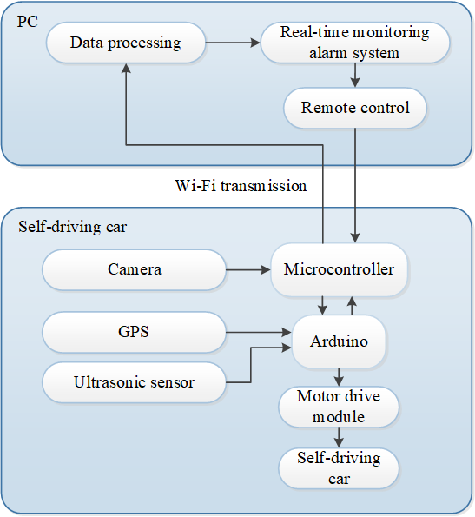
Research Methods
Autonomous Vehicle
Camera
GPS
Ultrasonic sensors
Wireless communication module (Wi-Fi)

Slide 4
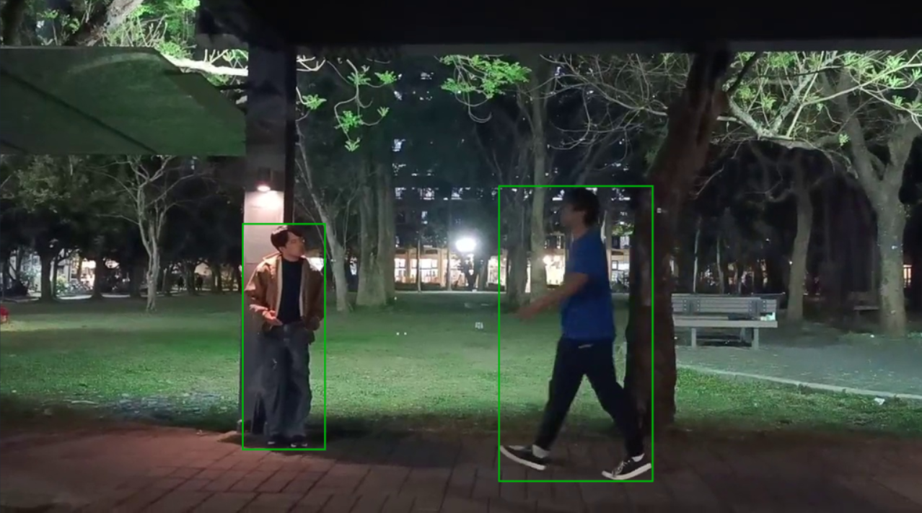
Research Methods
YOLO Human Detection
Normal
Need help
Suspicious

Slide 5
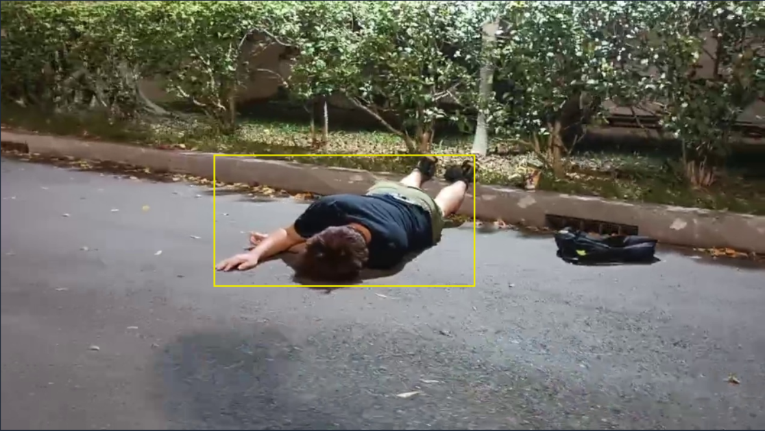
Research Methods
YOLO Human Detection
Normal
Need help
Suspicious

Slide 6
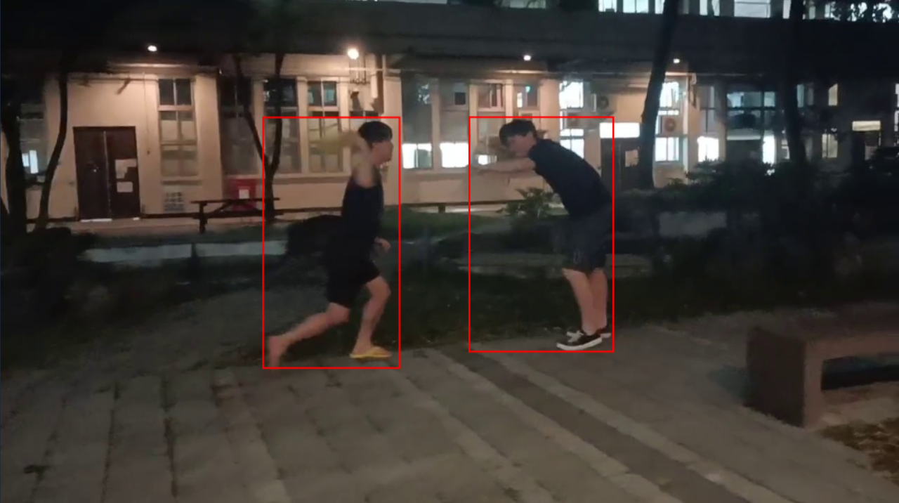
Research Methods
YOLO Human Detection
Normal
Need help
Suspicious

Slide 7
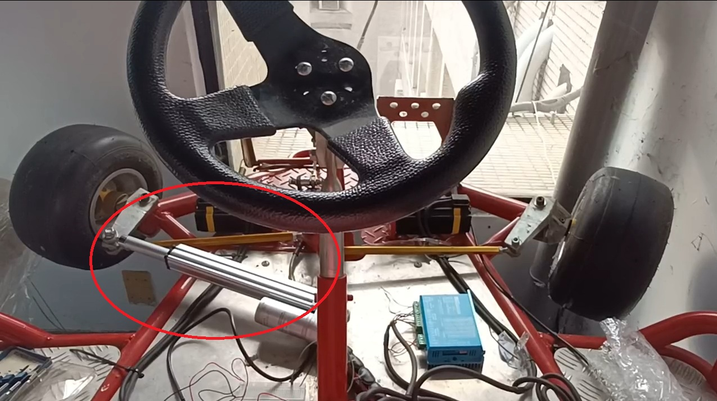
Progress Report - Completed Work
Autonomous Vehicle:
Stepper Motor Control
Electric Cylinder Control
GPS Antenna Testing

Slide 8
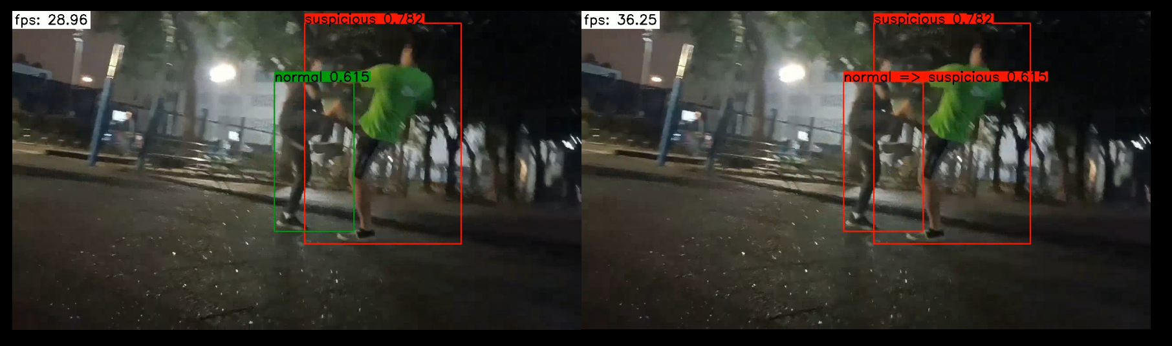
Progress Report - Completed Work
YOLO Human Detection

Slide 9
Progress Report - Problems & Solution
Autonomous Vehicle:
Arduino crash during operation.
> Emergency stop button and Remote stop functionality.

Slide 10
Progress Report - Problems & Solution
Autonomous Vehicle:
The Arduino's voltage output is insufficient to drive multiple components simultaneously.
> Use a power bank for additional power supply.

Slide 11
Progress Report - Problems & Solution
Autonomous Vehicle:
The control components are difficult to install onto the autonomous vehicle.
> Using acrylic plates to secure small components in place.

Slide 12
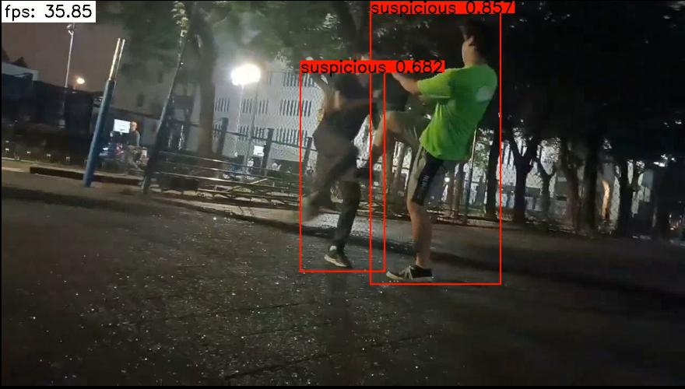

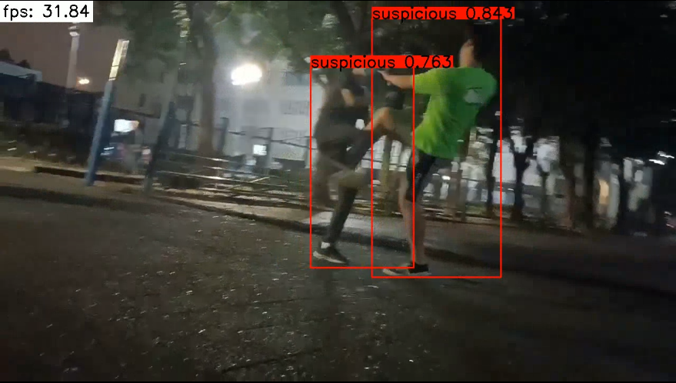
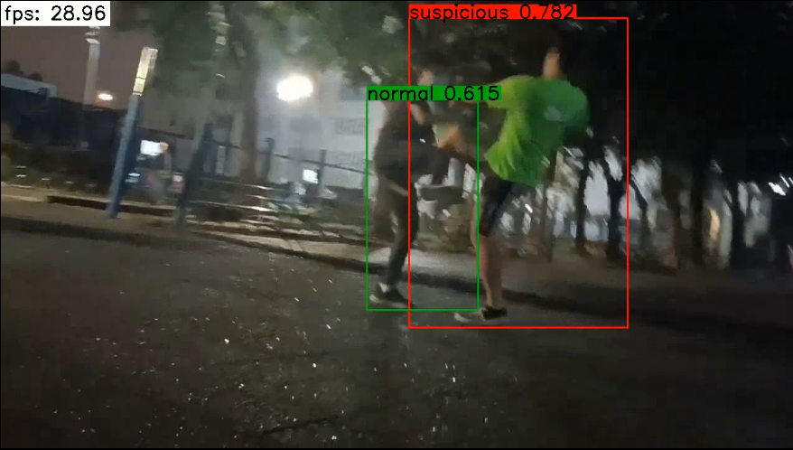
Progress Report - Problems
YOLO Human Detection:
Since suspicious individuals often perform continuous movements, some frames may be misclassified, leading to detection errors.

Slide 13
Progress Report - Solution
YOLO Human Detection:
> Incorporate detection results from previous frames for improved accuracy.

Slide 14
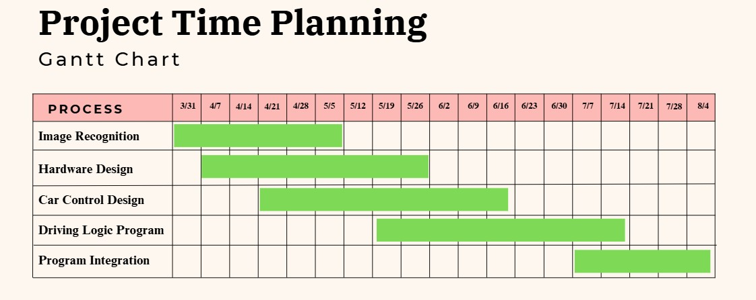
Project Time Planning

Slide 15
Work Assignment
B11107110 吳亮穎：
Image Recognition, Vehicle Control Design, Driving Logic Programming
B11107123 周世安：
Vehicle Control Design, Code Integration, Driving Logic Programming
B11130222 梁凱崴：
Hardware Design, Code Integration, Driving Logic Programming

Slide 16
Cost Estimation
Item Name | Description | Unit | Quantity | Unit Price | Total
Self-driving car chassis | Providing self-driving mobility capabilities | unit | 1 | 4500 | 4500
Microcontroller | Processing sensor data and navigation calculations | unit | 1 | 4000 | 4000
Image recognition module | Campus monitoring, object recognition | piece | 1 | 2500 | 2500
Ultrasonic Sensors | Detect obstacles to ensure safety | piece | 2 | 800 | 1600
GPS Module | Provide location information | set | 1 | 2500 | 2500
WiFi module | Return data and remote control | set | 1 | 2500 | 2500
Battery and Power Module | Provide stable power | set | 1 | 1500 | 1500
Parts and wire | Connection, fixing and assembly, etc. | set | 1 | 900 | 900
Total |  |  |  |  | 20000

Slide 17
Reference
教育部 校安中心. (2024). 112年各級學校校園安全及災害事件分析報告.
https://csrc.edu.tw/filemanage/detail/9bdcae78-83ea-4bb6-95e5-3b18b923ddc7
教育部. (2012). 維護校園安全實施要點.
https://edu.law.moe.gov.tw/LawContent.aspx?id=GL000492#lawmenu
Redmon, J., Divvala, S., Girshick, R., & Farhadi, A. (2016). You only look once: Unified, real-time object detection. Proceedings of the IEEE conference on computer vision and pattern recognition.
Zhang Sr, D., Shao, Y., Mei, Y., Chu, H., Zhang, X., Zhan, H., & Rao, Y. (2019). Using YOLO-based pedestrian detection for monitoring UAV. Tenth International Conference on Graphics and Image Processing (ICGIP 2018).
Shinde, S., Kothari, A., & Gupta, V. (2018). YOLO based human action recognition and localization. Procedia computer science, 133, 831-838.
Gul, M. A., Yousaf, M. H., Nawaz, S., Ur Rehman, Z., & Kim, H. (2020). Patient monitoring by abnormal human activity recognition based on CNN architecture. Electronics, 9(12), 1993.
Huu, P. N., Pham Thi, Q., & Tong Thi Quynh, P. (2022). Proposing Lane and Obstacle Detection Algorithm Using YOLO to Control Self‐Driving Cars on Advanced Networks. Advances in Multimedia, 2022(1), 3425295.
林冠穎. (2024). 影像深度辨識結合巡邏機器人之應用 國立雲林科技大學]. 臺灣博碩士論文知識加值系統. 雲林縣.
https://hdl.handle.net/11296/bmb39c

